Slide 1
CHE352 PROJECT
GROUP - 8
Naphtali Sandholm

Slide 2
GROUP MEMBERS
VIPUL KOHLI 160795
SAKSHAM MITTAL 170615
RAJAT CHAUDHARY 170540
SWASTIK SINGHAL 170747
KRISHAN TETARWAL 160338
SURAJ KUMAR 150741

Slide 3
01
TABLE OF CONTENTS
PROBLEM STATEMENT
02
DEGREE OF FREEDOM ANALYSIS
03
ALGORITHM
04
RESULTS FROM MATLAB AND ASPEN

Slide 4
Problem Statement
To simulate a multicomponent distillation column using Naphtali Sandholm and Newton Raphson algorithm incorporating vapor/liquid-phase non-idealities in MATLAB and ASPEN.
Compute Composition on each tray (including bottom and distillate).
Plot the Temperature Profile inside the distillation column.
To check the results obtained from MATLAB by performing rigorous simulation in ASPEN.
Type of Column - Conventional with partial reboiler
Column pressure 1 atm
Feed plate location 7
Number of plates inside column 17
Thermal condition of Feed Liquid at 330 K
Type of Condenser Total
Reflux ratio 9.5
Bottom flow rate 62 kmol/h
Components F*zi
Methanol 10 kmol/h
Acetone 30 kmol/h
Methyl Acetate 5 kmol/h
Benzene 20 kmol/h
Chloroform 20 kmol/h
Activity coefficients for liquid phase calculated using Wilson’s Activity Coefficient Model.
Fugacity coefficients for vapour phase are obtained from Redlich-Kwong equation of state.
Computed the non-ideal enthalpies using Enthalpy Departure Functions.

Slide 5
Degree of Freedom Analysis
1) Number of Components [ Methanol, Acetone, Methyl Acetate, Benzene, Chloroform ] ’c’= 5
2) Number of Stages [ Including Condenser and Reboiler ] ‘N’ = 19
3) Number of Independent Variables [ 3*N*c + 10*N + 1 ] = ‘476’
● Feed = 19 [ N ] ● Q = 19 [ N ] ● x, y, z = 3*19*5 [ 3*N*c ]
● T [ All Stages ] = 19 [ N ] ● L = 19 [ N ] ● No. of Trays [ N ] = 1
● T [ For Feeds at Each Stage ] = 19 [ N ] ● U = 19 [ N ]
● P [ All Stages ] = 19 [ N ] ● V = 19 [ N ]
● P [ For Feeds at Each Stage ] = 19 [ N ] ● W = 19 [ N ]
4) Number of Independent Equations made with the help of Naphtali Sandholm
[ 2*N*c + 3*N ] = ‘247’
● Mij = 19*5 [N*c]
● Eij = 19*5 [N*c]
● Hj = 19 [ N ]
● Sx and Sy = 2*19 [2*N]
5) Degrees of Freedom = Number of Independent Variables - Number of Independent Equations
= ( 3*N*c + 10*N + 1 ) - ( 2*N*c + 3*N ) = ( N*c + 7*N + 1 )
6) Values to be mentioned (N*c + 7*N + 1) = ‘229’
● Feed = 19 [ N ] ● zi = 19*5 [ N*c ]
● T [ For Feeds at Each Stage ] = 19 [ N ] ● U = 19 [ N ] ● No. of Trays [ N ] = 1
● P [ All Stages ] = 19 [ N ] ● W = 19 [ N ]
● P [ For Feeds at Each Stage ] = 19 [ N ] ● Q = 19 [ N ]
Since all the required values are mentioned, therefore the system is sufficiently defined.

Slide 6
Naphtali Sandholm Formulation
Converting to MEH equation --
● Lj*xi, j = li, j
● Vj*yi, j = vi, j
● Fj*zi, j = fi, j
Substituting Assumptions of Naphtali Sandholm in equations, we get --
● Mass Balance -
Mi, j => -li, j-1 - vi, j+1 - fi ,j + [ 1+sj ]*li, j + [ 1+Sj ]*vi, j = 0
● Equilibrium equations -
Ei, j => -vi, j + ki, j*[ Vj/Lj ]*li, j = 0
● Enthalpy Balance -
Hj => -[ Lj-1hLj-1 ] - [ Vj+1hVj+1 ] - [ Fj*hFj ] + [ [ 1+sj ]*hLj*Lj ] + [ [ 1+Sj ]*hVj*Vj ] + Qj= 0
Taking Initial guess by -
● Solving Ratchford Rice Equation (considering flash separation) to calculate L,V.
● Assuming Temp. of plates by Interpolating the Minimum and Maximum Boiling Points.
Initial Topmost plate temperature = min boiling point(acetone)
Initial Bottommost plate temperature = max boiling point(benzene).

Slide 7
Flow Chart
Modified MESH equations to MEH equations using NAPHTALI SANDHOLM
Evaluated a new guess using Jacobian Formula
Convergence criteria satisfied ?
Did degree of freedom analysis
Formulated A, B and C matrices thereby forming the dF/dX matrix
Initialization of Tj, Vj, Lj in a vector Xj
Calculated the Mij, Eij, Hj and formed a vector Fj
No
Yes
Stop

Slide 8
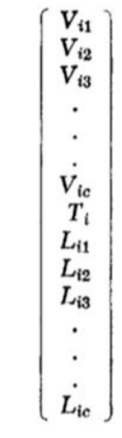



ALGORITHM
Initial guess for Vij, Tij, Lij using vector x
Vector Fi (include calculated values of Hi, Mij, Eij)
Ei, Mij, Qij (in the figure) represents Hi (enthalpy balance), Mij (material balance) and Eij (equilibrium equations) respectively

Slide 9
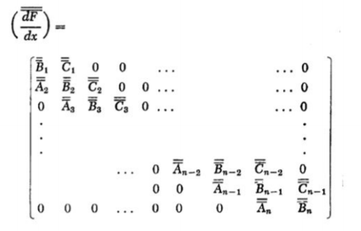
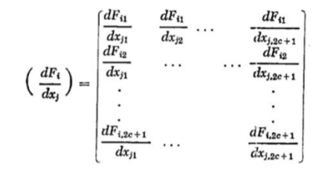

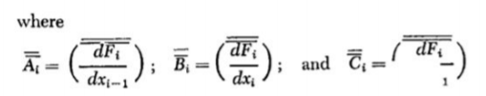
ALGORITHM
Evaluation of new guess using Jacobian Formula and Newton-Raphson Method :-
Solving Using Thomas Algorithm :-

Slide 10
ALGORITHM
Functions:
1) Enthalpy_Vapour and Enthalpy_Vapour Function: To Calculate the Enthalpy at each stage for the Vapor and Liquid phase, along with Non-Ideality [Departure function using Redlich Kwong EOS]
2) ratchford_rice Function: To Calculate initial guess of flow values assuming ideal Flash Separation
3) Enthalpy_Equation Function: To Calculate Enthalpy equation for all the stages
4) Material_Equation function: To Calculate Material Balance Equations for all components and stages
5) Equilibrium_Equation function: To Calculate Equilibrium Equations for all components and stages
6) Enthalpy_Stage function: To Calculate Enthalpy Equation at a given stage, used for evaluating Partial derivatives
7) Material_Stage function: To Calculate Material Balance Equations for all components at a given stage
8) Equilibrium_Stage function: To Calculate Equilibrium Equations for all components at a given stage
9) Matrix_A, Matrix_B, Matrix_C function: To find Aj, Bj, Cj matrices for a given stage. Derivatives are calculated using Central Finite Difference Method
10)Activity Function: To Calculate Activity Coefficients using WILSON Activity Model

Slide 11
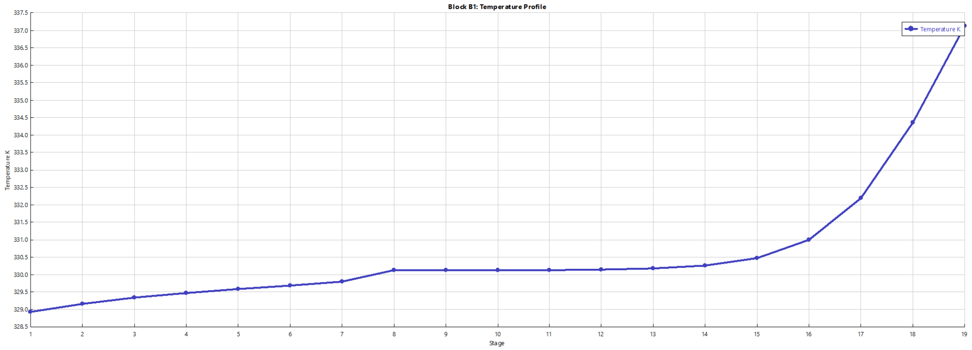
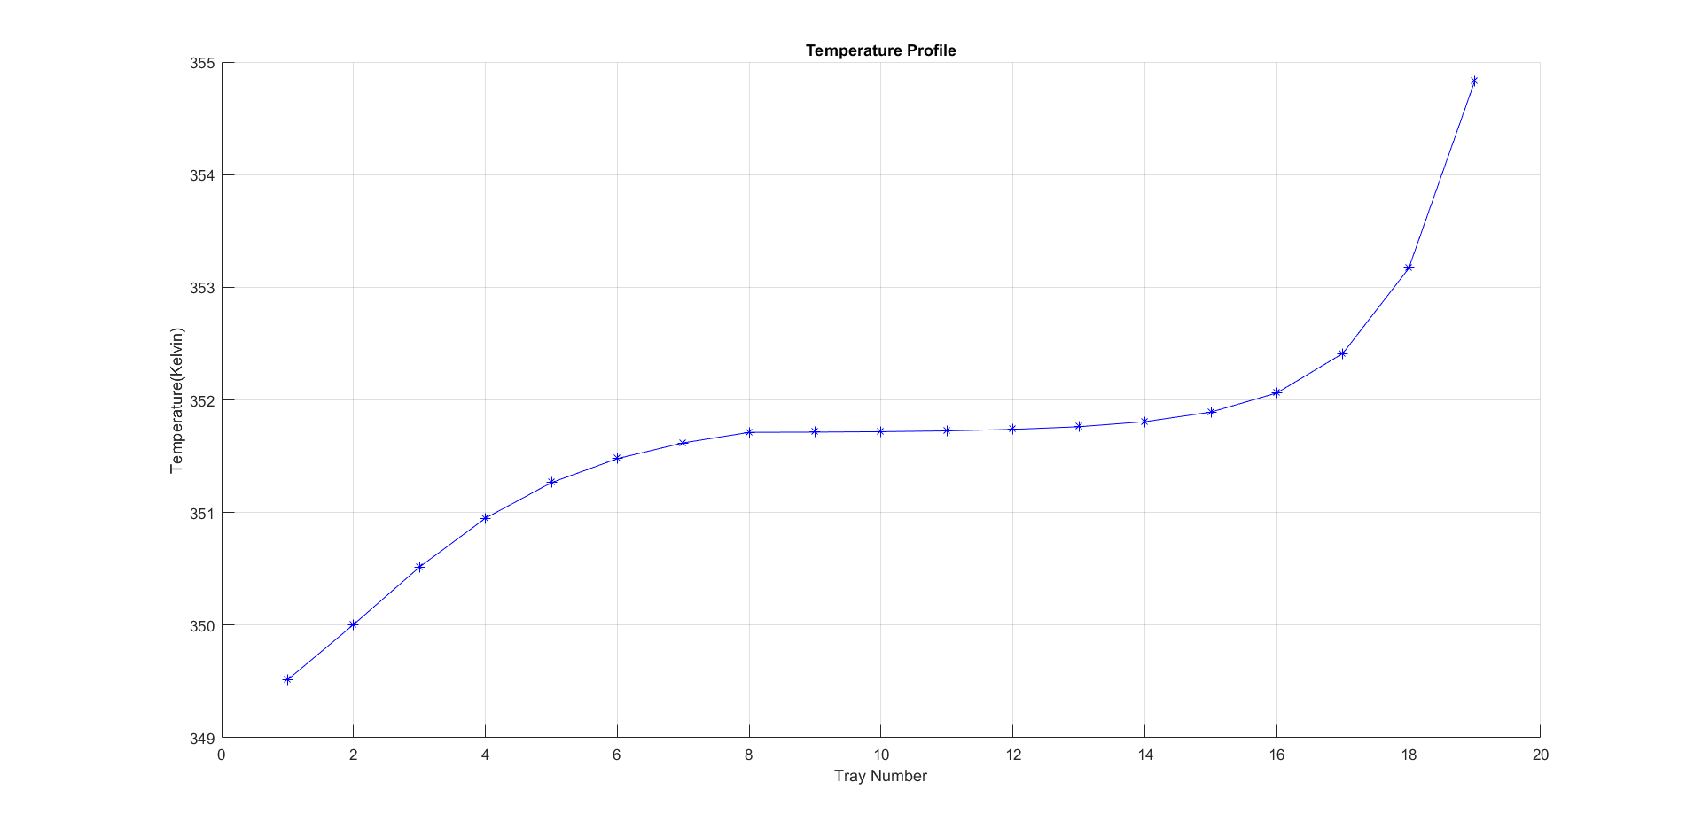
Results
Temperature profiles obtained from both Matlab and Aspen

Slide 12
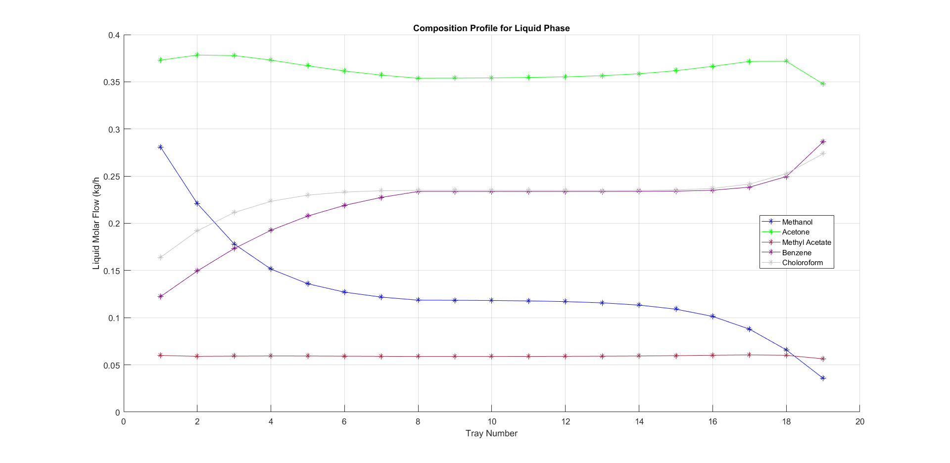
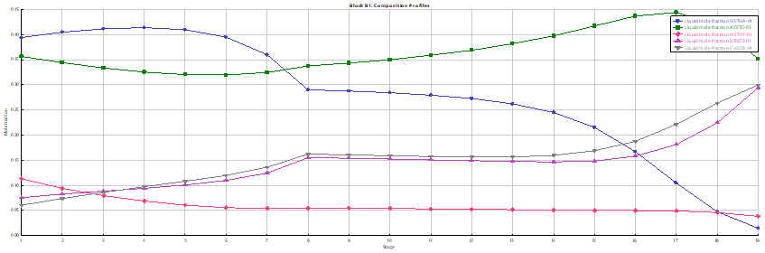
Results
Composition of each component at each stage in liquid phase

Slide 13
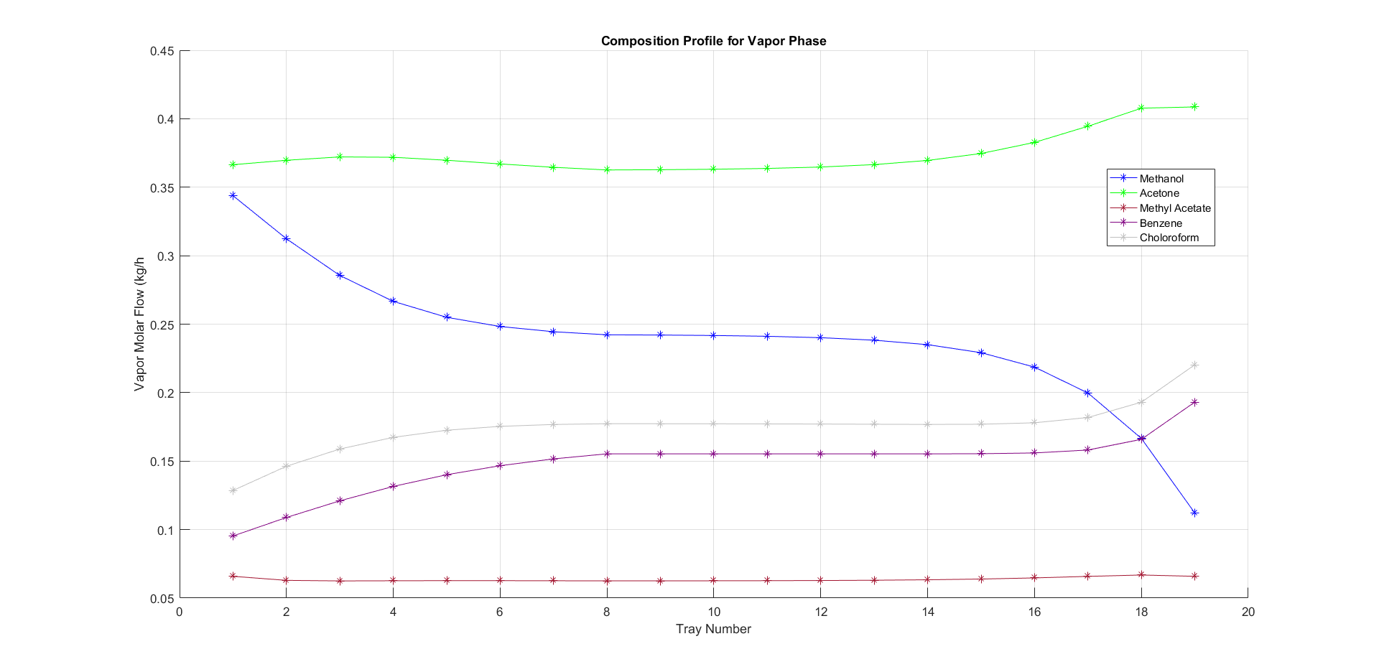
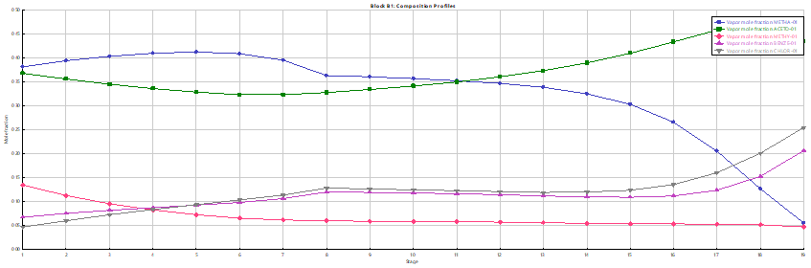
Results
Composition of each component at each stage in vapour phase

Slide 14
References
For Thermodynamic Principles
Separation Process Principles Book by Ernest J. Henley and J. D Seader.
Engineering and Chemical Thermodynamics Book by Milo D. Koretsky.
Chemical Process Modelling and Computer Simulation by Amiya K. Jana.
Prediction of Multicomponent Vapor-Liquid Equilibrium with the Wilson Equation by Norman Silverman and Dimitrios Tassios.
For Algorithm:
Multicomponent Separation CaIcuIations by Linearization Book by Leonard M. Napthali and Donald P. Sandholm.
For Experimental Data:
NIST Webbook : https://webbook.nist.gov/chemistry
Perry’s Chemical Engineering Handbook

Slide 15
Individual Contributions
1) VIPUL KOHLI: Aspen, MATLAB code, Degree of freedom analysis.
2) SAKSHAM MITTAL: MATLAB code, Presentation, Debugging.
3) RAJAT CHAUDHARY: MATLAB code, Presentation, Debugging.
4) SWASTIK SINGHAL: Degree of freedom analysis, Debugging, Presentation.
5) KRISHAN KUMAR TETARWAL: Debugging, Presentation.
6) SURAJ KUMAR : Aspen, Debugging.

Slide 16
Thank You.

